Slide 1
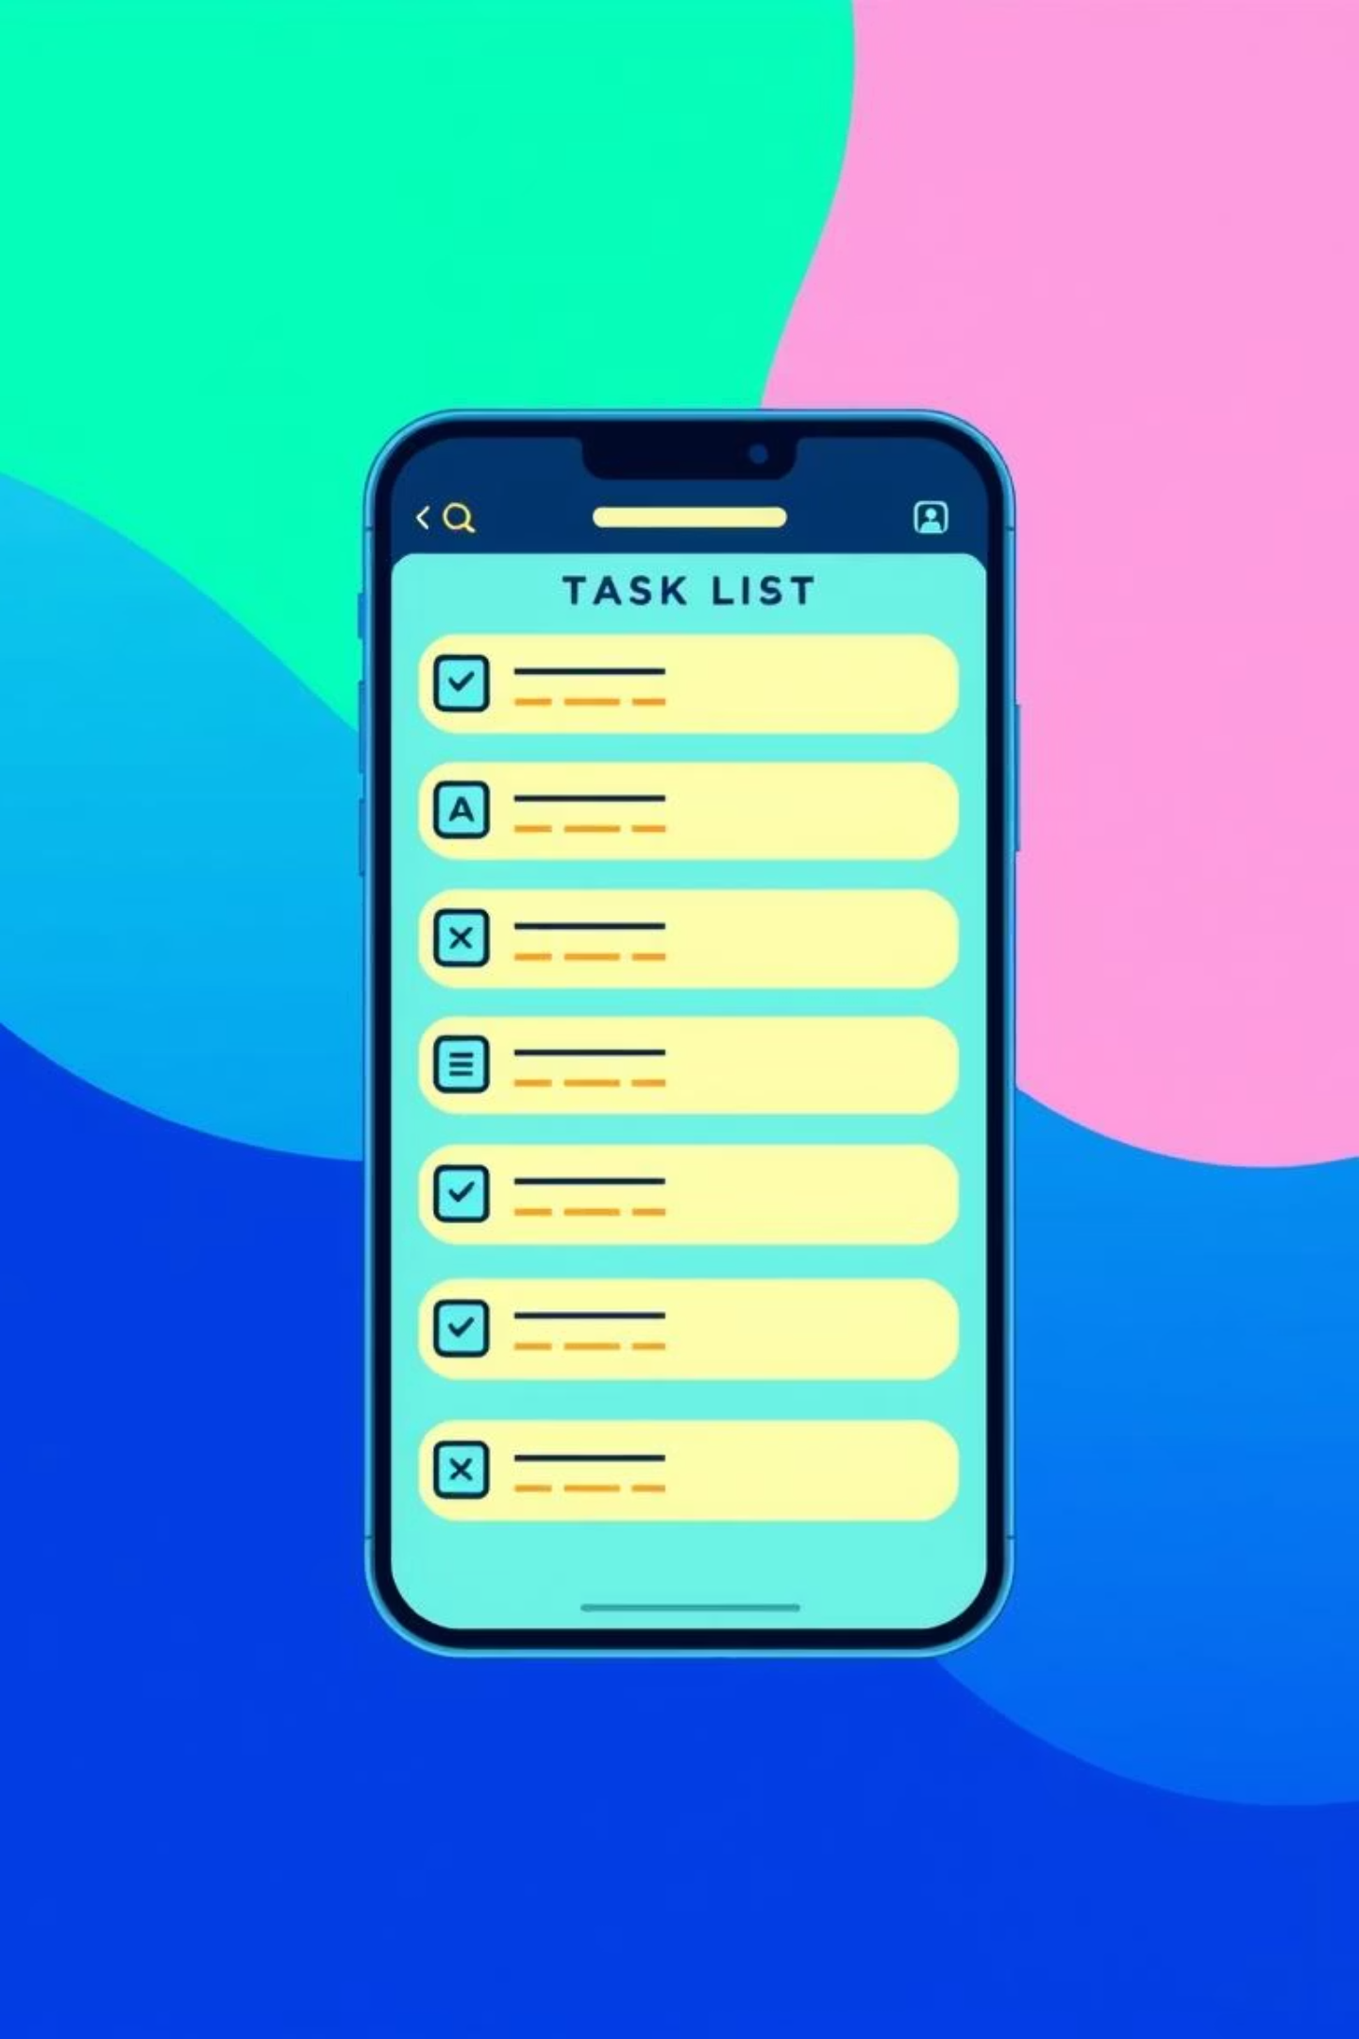
Simple Task Manager Application
Presented by Group Four (4)

Slide 2

Introduction: The Need for Simplicity
Task management is crucial in daily life, yet traditional methods often lead to disorganization and missed deadlines. Digital tools have emerged to boost productivity, but many are overly complex.
Problem Statement
Individuals struggle with task organization, leading to lost information, missed deadlines, and increased stress. Existing digital solutions are often too complex or costly.
Our Solution
A simple, lightweight, and easy-to-use task manager focused on essential features: creation, reminders, and prioritization.

Slide 3
Aim & Objectives
The aim is to develop a Simple Task Manager Application that enhances user productivity by simplifying task planning and tracking.
01
02
03
Intuitive Interface
Priorities & Deadlines
Task Reminders
Design and implement an interface for adding, editing, and deleting tasks.
Enable users to assign priorities and deadlines to tasks.
Incorporate reminders for upcoming tasks.
04
05
Efficient Storage
Usability Evaluation
Store tasks efficiently for later retrieval.
Evaluate the usability and performance of the application.

Slide 4

Significance & Scope
This project improves personal productivity and serves as educational material for software development processes.
Significance
Scope
Helps students manage academic tasks.
Create, modify, prioritize, and delete tasks.
Improves personal productivity for busy individuals.
Send notifications and store tasks locally.
Excludes collaboration, cloud sync, or advanced analytics.
Provides a foundation for future research on lightweight productivity tools.

Slide 5
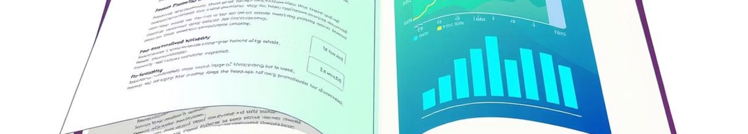
Literature Review: Learning from Existing Solutions
This chapter reviews theories and existing task management applications to determine the relevance of our proposed Simple Task Manager.
1
2
3
Task Management
Productivity Tools
Existing Systems
Digital tools reduce cognitive load and enhance productivity (Adebayo & Ogunleye, 2022; Basri & Farliana, 2020).
Help organize workflow; simple interfaces improve user performance (Nielsen, 2012; Allen, 2001).
Often complex, cloud-reliant, and overwhelming for beginners (Basri & Farliana, 2020; Wang & Chou, 2020).

Slide 6
Comparative Analysis: Our Simple Approach
Our Simple Task Manager focuses on essential functionality and usability, contrasting with more complex existing applications.
Complexity
Moderate to high
Low
Cost
Sometimes premium
Free
Learning Curve
Moderate
Very easy
Target Users
Professionals
Students & individuals

Slide 7





Methodology: Building Our Application
We adopted the Software Development Life Cycle (SDLC) Waterfall Model for its structured approach, ensuring a systematic development process.
Research Design
SDLC Waterfall Model.
Requirements Gathering
Interviews, observation, existing system analysis.
System Design Tools
Use Case, Activity, Class, and System Architecture Diagrams.
Development Tools
JavaScript, Next.js, LocalStorage, Git.
Testing Method
Black-box testing for functionality.

Slide 8
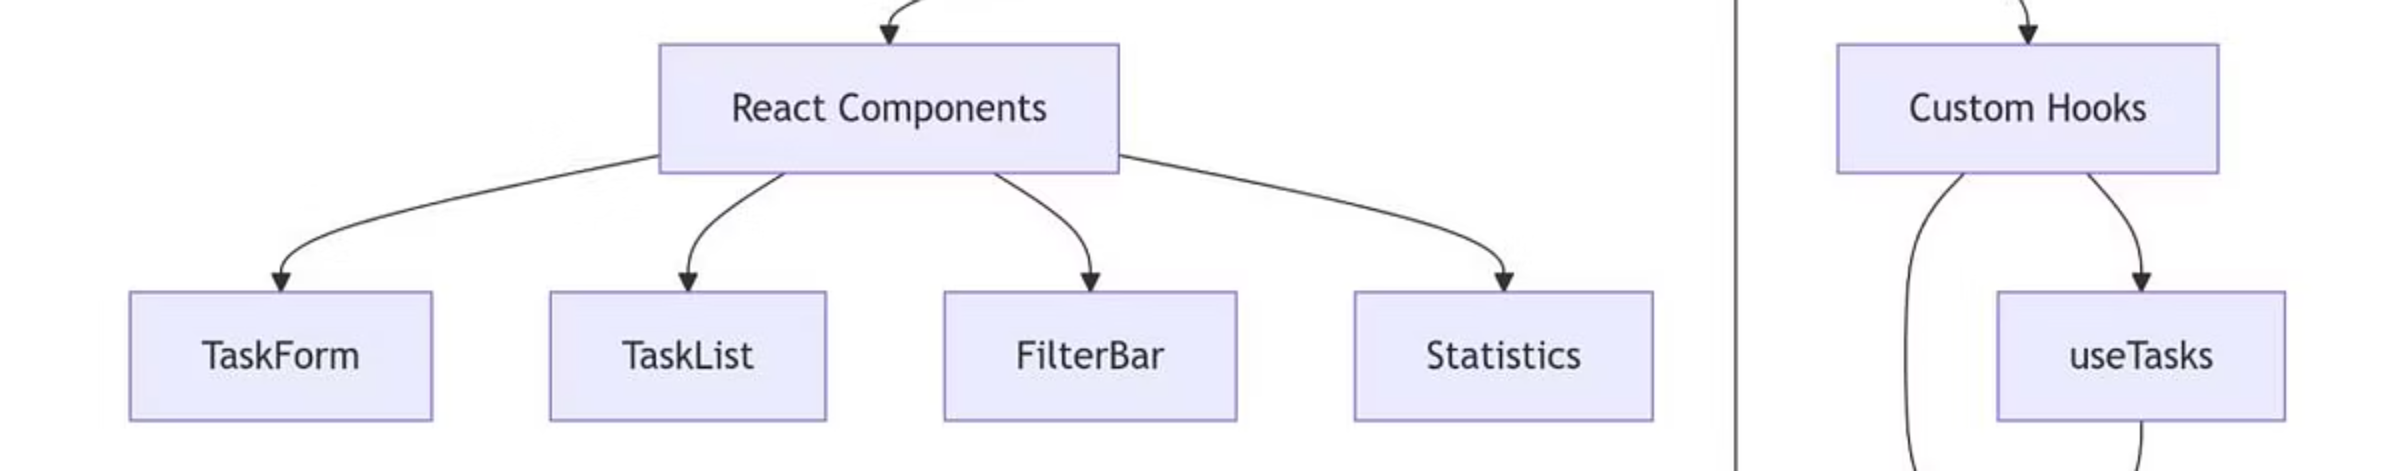
Software Development: Architecture & UI
Our application uses a client-side three-layer architecture, focusing on simplicity, efficiency, and user-friendly interaction.
Presentation Layer
Application Logic Layer
Data Storage Layer
Built with Next.js and Tailwind CSS for responsive UI (Task List, Modals).
Manages task operations (create, edit, delete, complete) using React hooks and helper functions.
Local Storage for persistence across browser sessions, storing tasks as JSON.

Slide 9
Software Testing: Ensuring Quality
Comprehensive testing verified accuracy, stability, and usability across various browsers, with all test cases passing successfully.
100%
100%
Functional Testing
Usability Testing
All features work as expected.
Easy navigation and user experience.
100%
100%
Compatibility Testing
Performance Testing
Consistent performance across Chrome, Firefox, Edge.
Fast rendering and responsiveness.

Slide 10
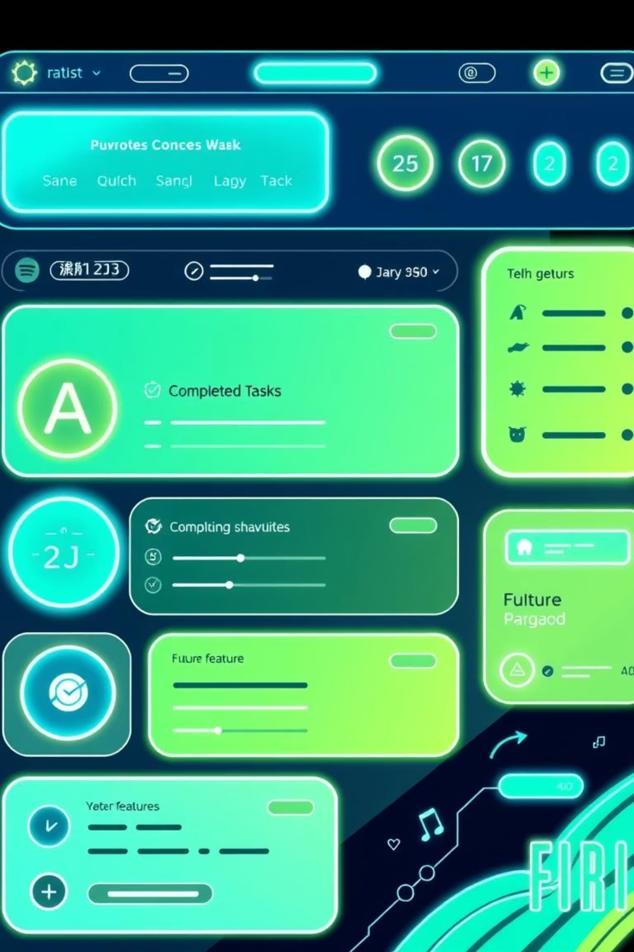
Results & Future Enhancements
The Simple Task Manager successfully meets its objectives, providing a lightweight, responsive, and easy-to-use solution for daily task management.
Key Features
Future Enhancements
Create, view, edit, delete, and mark tasks as completed.
Push notifications/reminders.
Persistent storage via Local Storage.
Cloud synchronization & user accounts.
Clean, responsive interface with UUID for unique IDs.
Task categorization & dark mode UI.

